Slide 1
KP Performance Test Report Week 42

Slide 2
Objective
The purpose of the testing is to assess the behaviour of the KP over an extended period of time and performing multiple dispenses daily.
Dispense accuracy
Smart valve and polyurethane hose performance
Other component performance (pump, flowmeter & solenoid etc)
Overall performance of the KOKOPoint
Simulate KP use by 20 different canisters

Slide 3
Test Setup
Four calibrated KOKOPoints
20 canisters
Measure the first two and last two dispenses of the day
300ml
2000ml
40 dispenses (of 2L each) per KOKOPoint per day
Time period
Start: 28th August 2019
End: 18th October 2019
Total dispensed volume in this time period - 1790L
Total dispenses - 1380

Slide 4
KP Dispensing Performance
Pp - the KP spread compared to the specification spread
Ppk - indicates whether the system is meeting the specifications
High Ppk value - process is stable
Low Ppk value - process may need improvement
Ppk Value | % Output within Specification
0.5 | 87.8
0.8 | 98.4
1.0 | 99.7
1.2 | 99.97
1.33 | 99.99

Slide 5
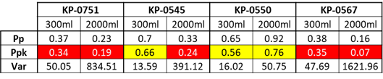
KP Dispensing Performance Cont.
Errors
KP-0751 - Random canister full error.
KP-0545 - No errors
KP-0550 - Connectivity issues (canister cannot be verified)
KP-0567 - KP crashed after first dispense and again after error 092

Slide 6
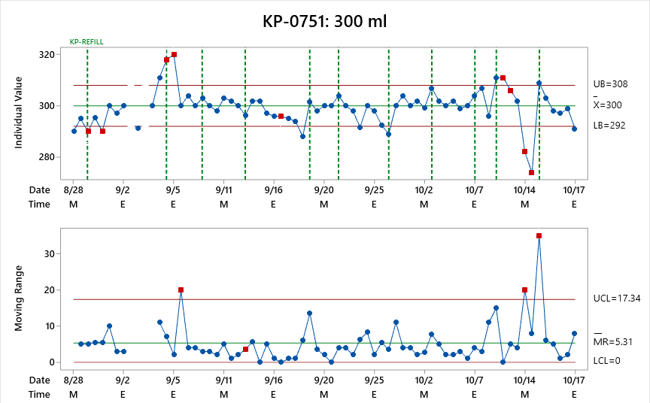
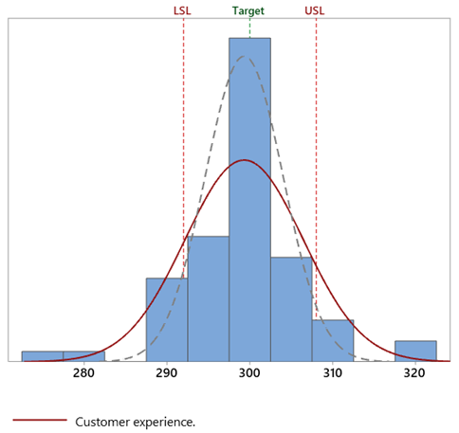
KP-0751: 300 ml Dispense
Summary
23.19% of the dispense volume out of the specified limits

Slide 7
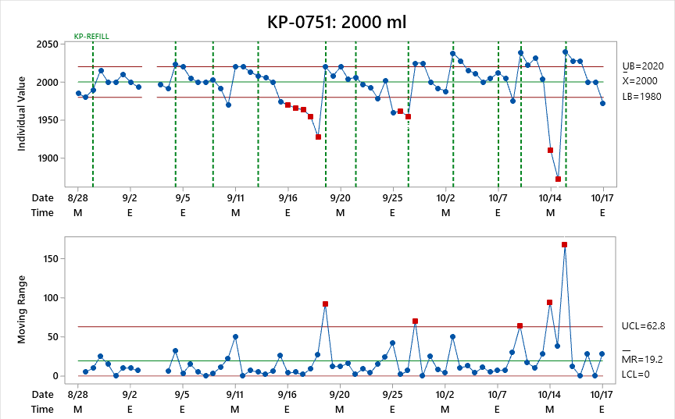
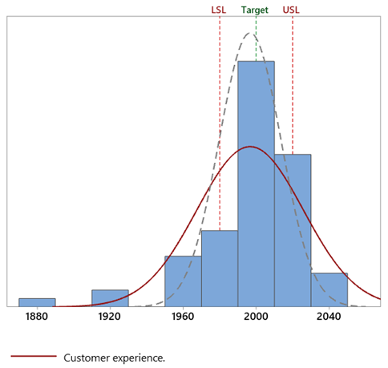
KP-0751: 2000 ml Dispense
Summary
37.68% of the dispense volume out of the specified limits

Slide 8
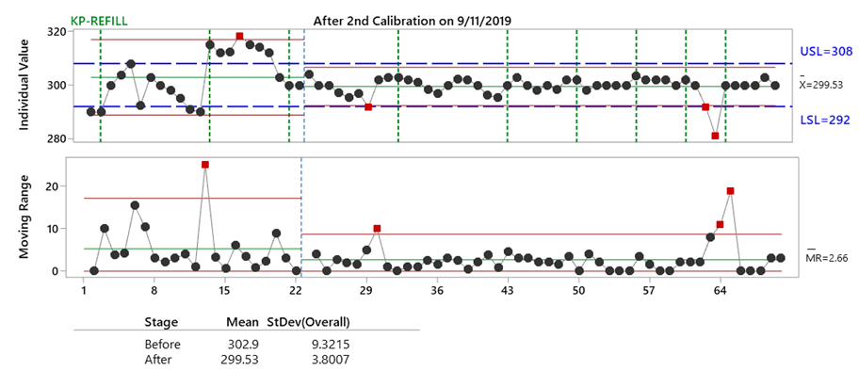
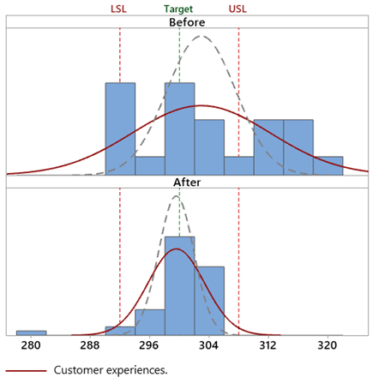
KP-0545: 300 ml Dispense
Summary
KP was re-calibrated on 9/11/2019.
Reduced standard deviation.
95.8% reduction in % dispense volume outside of specification (from 50.00% to 2.08%)
The two identified volumes out of spec is due to “noise” from ethanol sensor (to be investigated further).

Slide 9
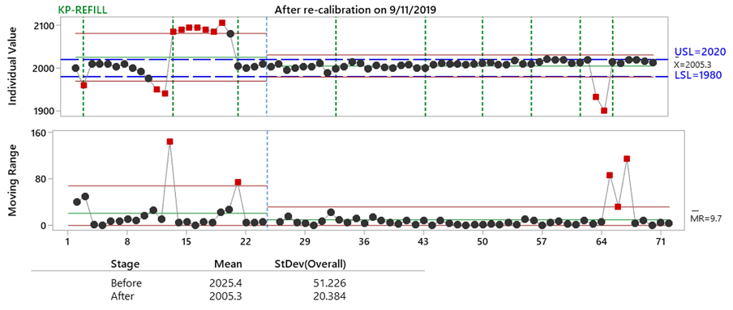
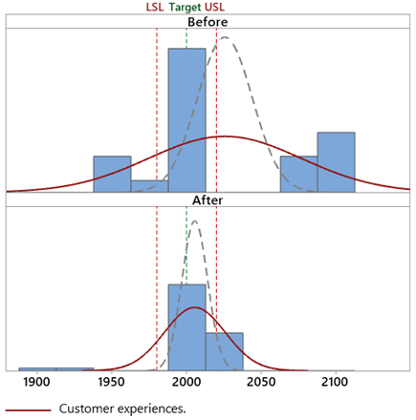
KP-0545: 2000 ml % Error
Summary
KP was re-calibrated on 9/11/2019.
Reduced standard deviation.
87.5% reduction in % dispense volume outside of specification (from 50.00% to 6.25%)
The two identified volumes out of spec is due to “noise” from ethanol sensor.

Slide 10
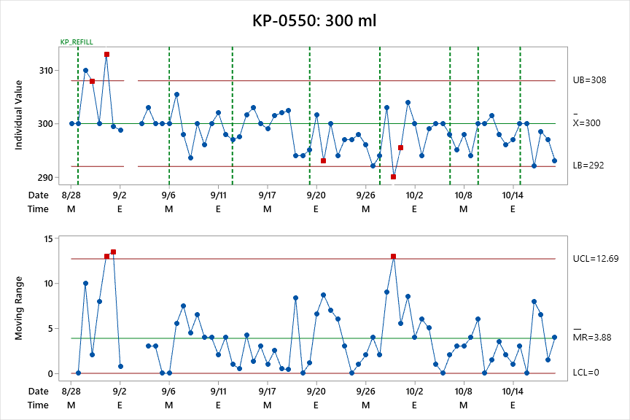
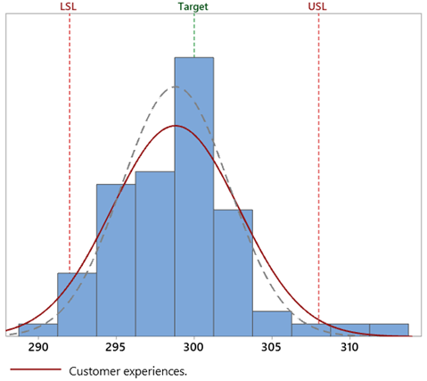
KP-0550: 300 ml Dispense
Summary
4.41% of the dispense volume out of the specified limits

Slide 11
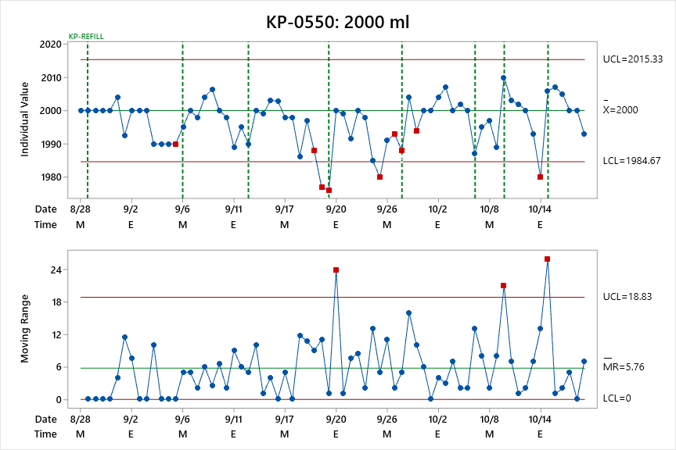
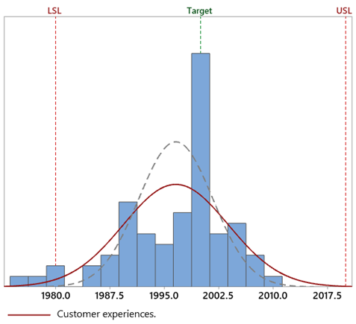
KP-0550: 2000 ml Dispense
Summary
2.86% of the dispense volume out of the specified limits

Slide 12
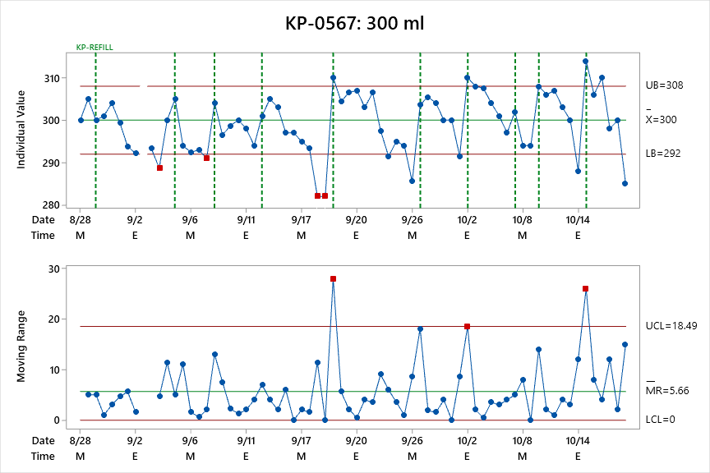
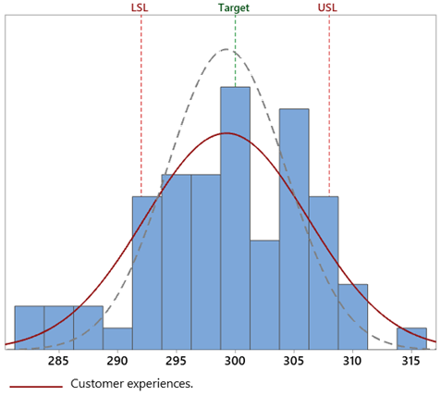
KP-0567: 300 ml Dispense
Summary
18.84% of the dispense volume out of the specified limits

Slide 13
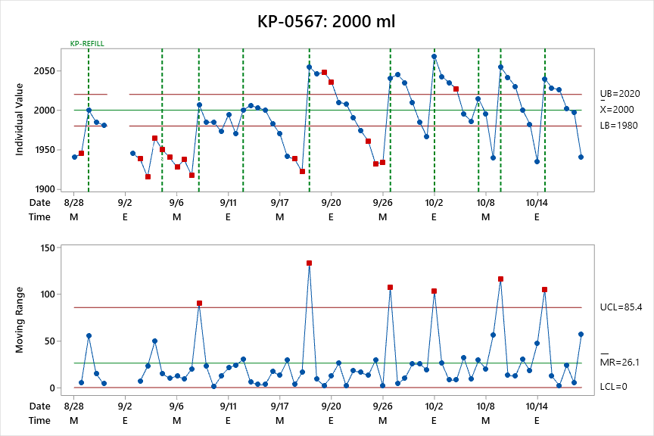
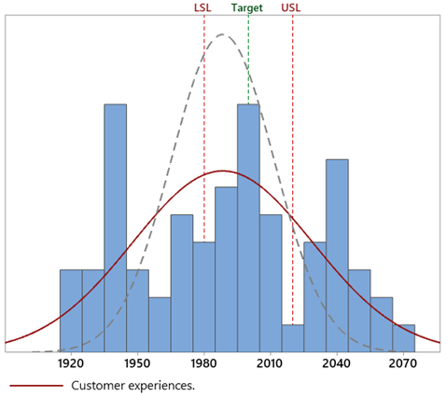
KP-0567: 2000 ml % Dispense
Summary
62.69% of the dispense volume out of the specified limits

